Slide 1
Rails Assessment
Aaron & Glen

Slide 2
Design
Very minimal CSS and styling
Focus on Database design and tinkering with Rails
Separation of duties

Slide 3
Building
Began with the bulk of CRUD mechanics
1 feature at a time and work in small steps

Slide 4
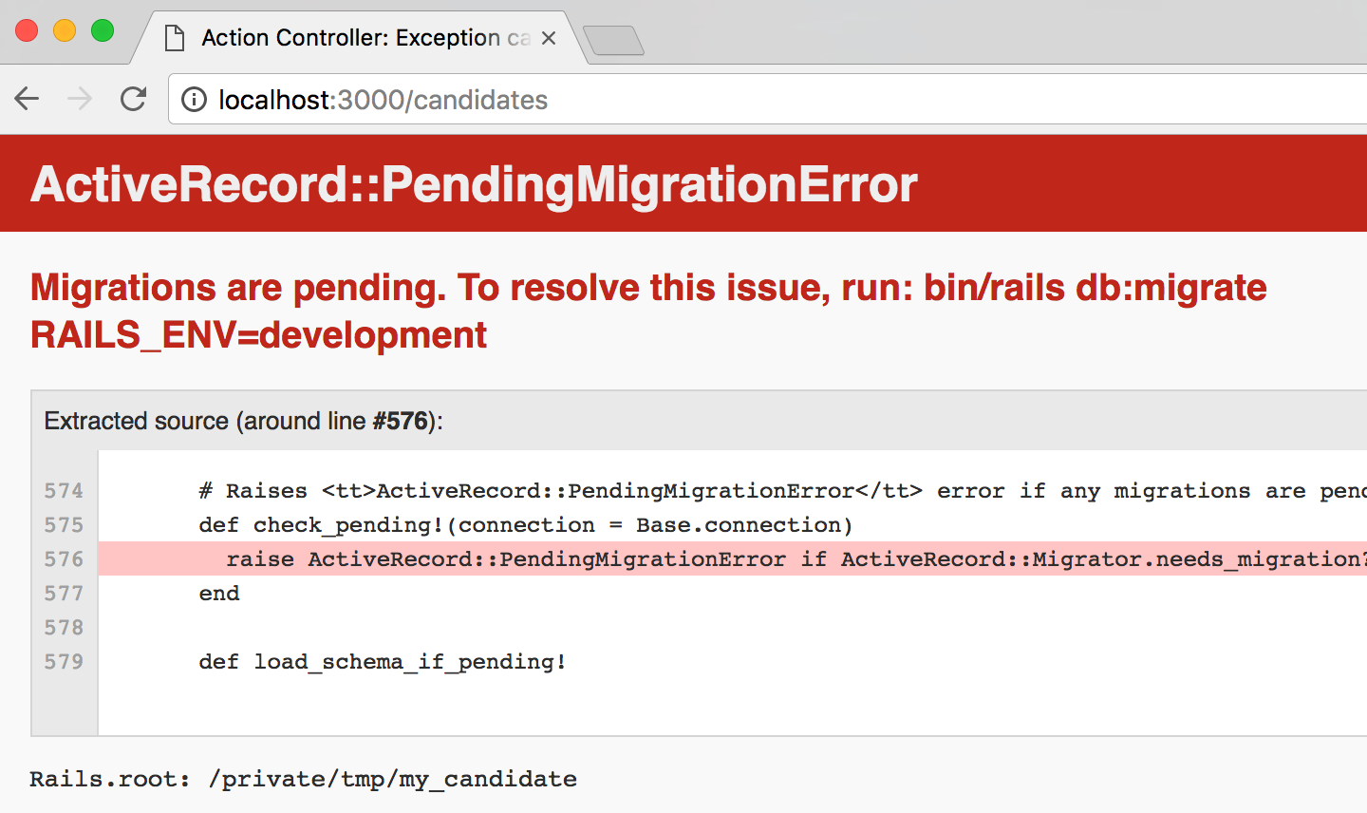
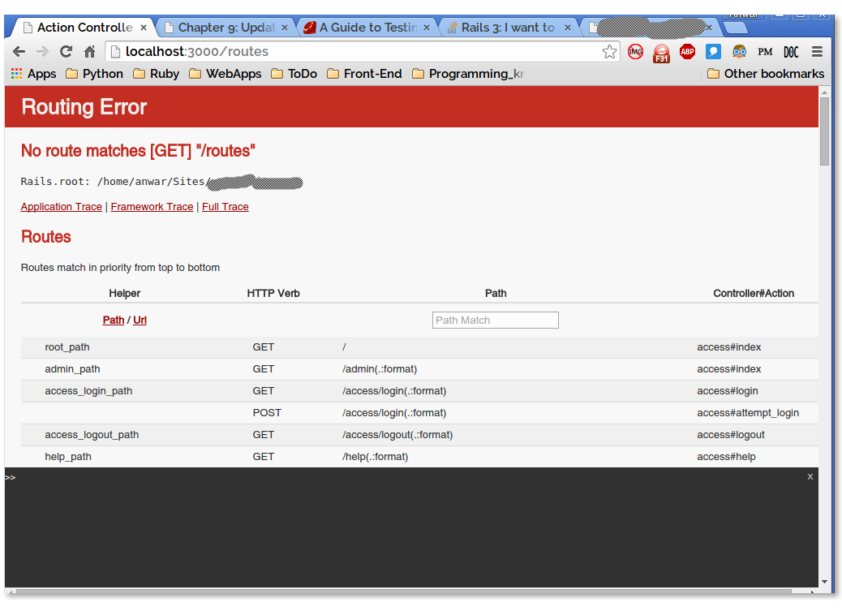
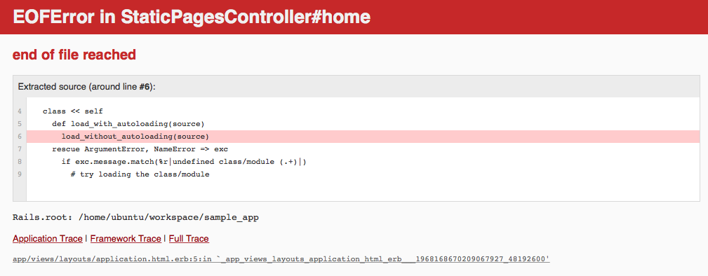
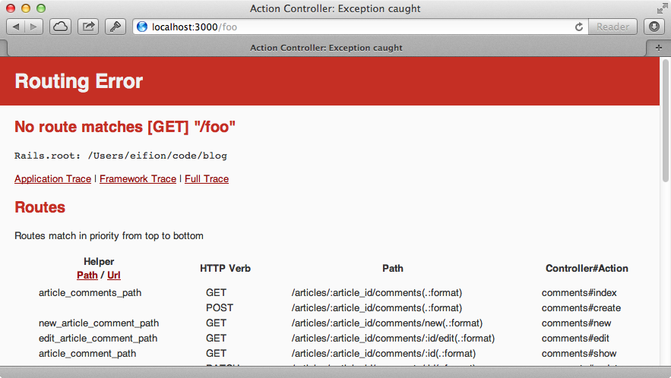
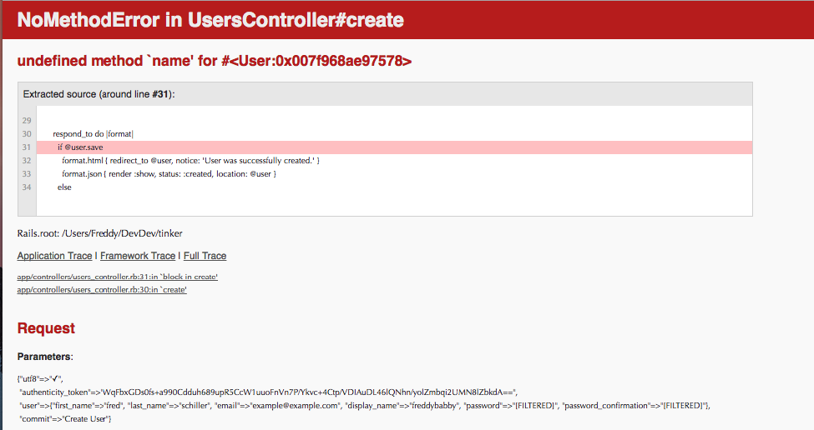
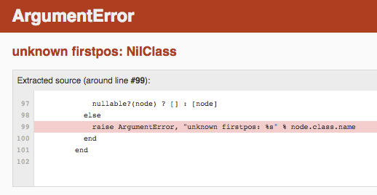
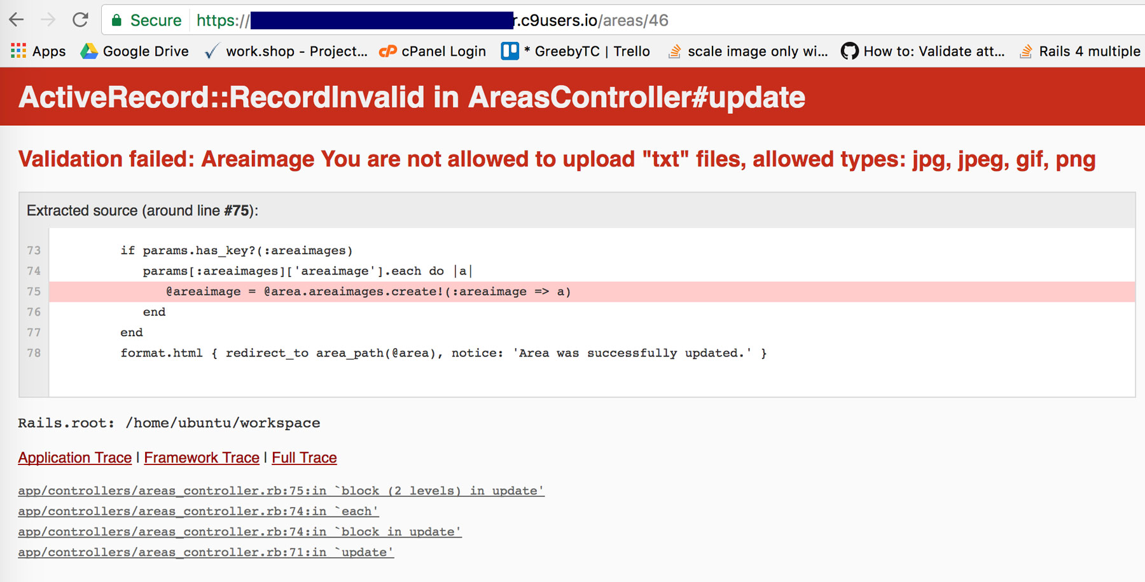
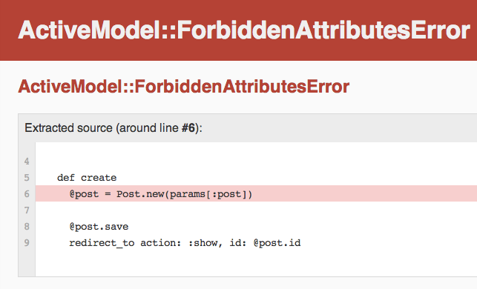
Challenges
Rails just sometimes breaking
Syntax

Slide 5
Walkthrough

Slide 6
Questions?

